Slide 1

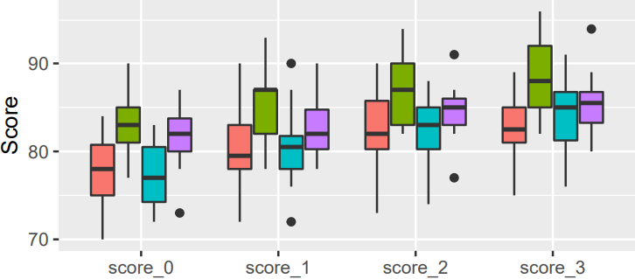
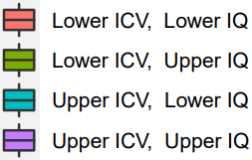
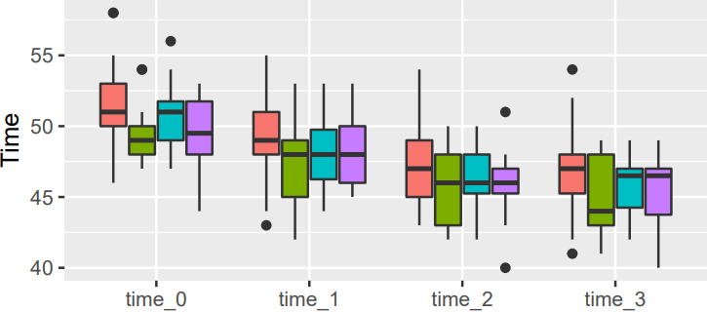
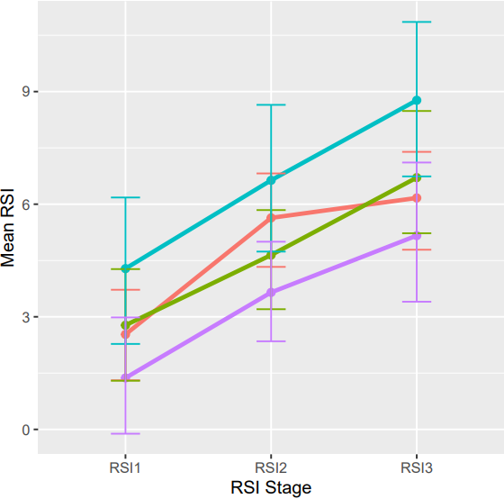
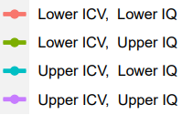
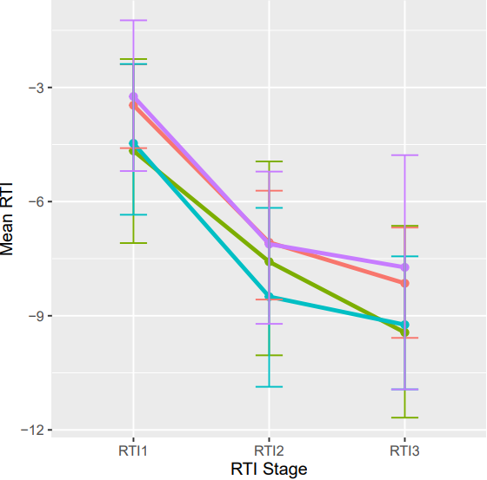


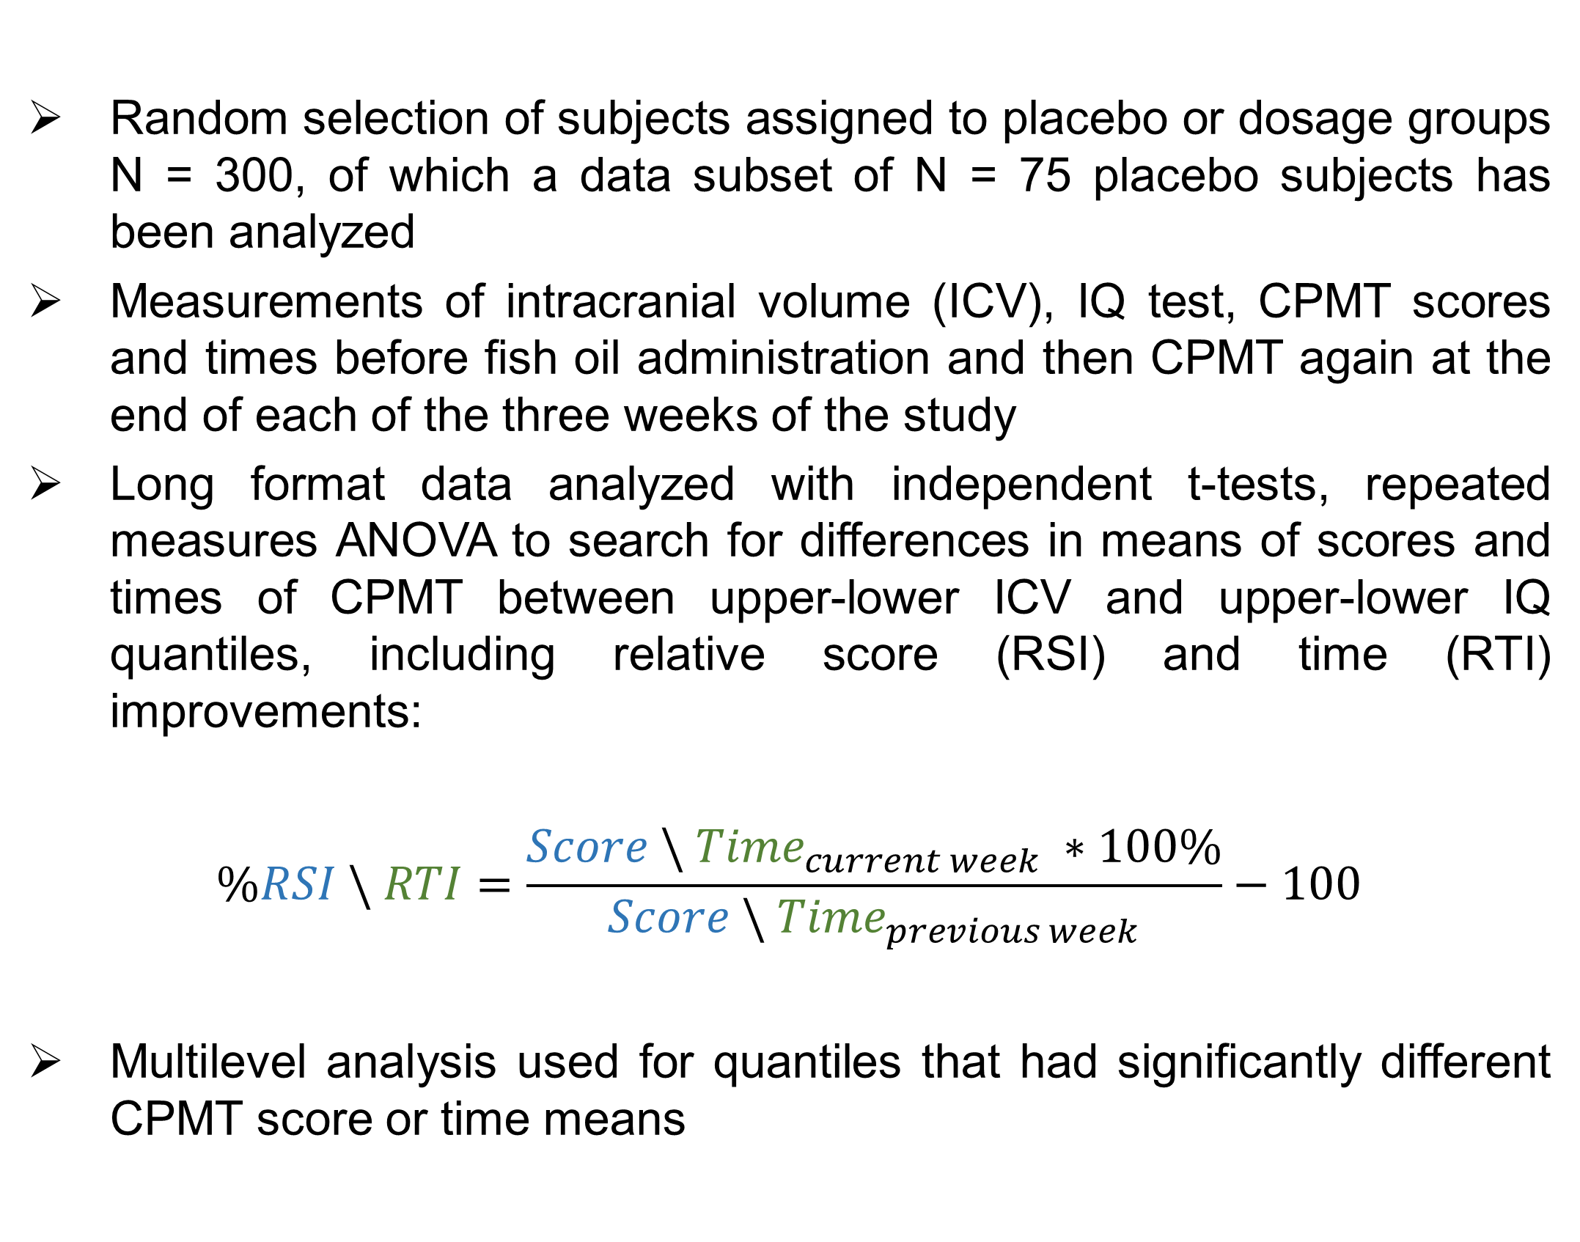
Influence of familiarity effect on Cognitive Processing Math Task (CPMT) performance in placebo-dosed subjects from a Fish Oil study
Student M. Trajdos¹
¹ Center for Neurogenomics and Cognitive Research, Neuroscience Campus Amsterdam, Vrije Universiteit, Amsterdam, Netherlands
Background
Methods
Random selection of subjects assigned to placebo or dosage groups N = 300, of which a data subset of N = 75 placebo subjects has been analyzed
Measurements of intracranial volume (ICV), IQ test, CPMT scores and times before fish oil administration and then CPMT again at the end of each of the three weeks of the study
Long format data analyzed with independent t-tests, repeated measures ANOVA to search for differences in means of scores and times of CPMT between upper-lower ICV and upper-lower IQ quantiles, including relative score (RSI) and time (RTI) improvements:
$$\%RSI \backslash RTI=\frac{Score \backslash {Time}_{current week} ∗100\%}{Score \backslash {Time}_{previous week}}−100$$
Multilevel analysis used for quantiles that had significantly different CPMT score or time means
Manufacturers of vitamins and supplements claim that fish oil improves brain functioning
To separate the effect of fish oil administration, we examined the effect of Cognitive Processing Math Task (CPMT) familiarity on performance in CPMT in terms of score and completion time
Research question: Do placebo subjects improve in CPMT scores and times due to developed familiarity with the task, regardless of their ICV and IQ?
Hypotheses:
Ho: Lower or upper ICV or IQ does not influence score and time performance of placebo subjects. Ha: Lower or upper ICV or IQ do influence score and time performance of placebo subjects. Ho: There is no increase of CPMT scores and no decrease of CPMT times in placebo subjects, suggesting increased performance reliant on fish oil administration. Ha : There is an increase of CPMT scores and a decrease of CPMT times in placebo subjects, suggesting increased performance due to developing a familiarity with the task.
Results
Score means at baseline and at each week were significantly different between lower and upper IQ: t(298)= -7.44, p= 1.08e-12, same for time means: t(298)= 3.56, p= 4.3e-04, but not mean scores t(298)= -0.29, p= 0.77 and times t(298)=1.52, p=0.13 between upper and lower ICV (two-sided).
Increments were very significant across ICV in RSIs: F(2, 148)= 54.72, p< 1.1e-16 and decrements in RTIs: F(2, 148)= 56.21, p< 1.1e-16, and significant for different across upper and lower IQ in RSIs increments: t(73)=1.73, p=0.04, but not in RTIs decrements: t(73)= 0.04, p=0.51 (one-sided).
Code
Conclusions
Based on highly significant p-values of two-sided independent t-tests, we concluded that CPMT score and time means are significantly different between lower and upper IQ, but not between lower and upper ICV
This allowed us to use repeated measures ANOVA for RSI and RTI comparisons, but differences in score and time means for lower and upper IQ introduced a new level into our data, therefore we decided to fit a random intercept model and then use one-sided independent t-tests
Familiarity with the test over time seems to increase means of RSIs and decreased means of RTIs across ICV, as proven by significant p-values for RSI and RTI tests
There was an increase within means of RSIs in between lower and upper IQ, also due to the familiarity effect, however between same groups decrease within means of RTIs had not been observed
Further research is needed as nearly 15% of the sample was above absolute z-score of 1.96, proving poor representation of the actual data – study needs an increase in sample size and also take other factors, such as age and sex into consideration, to see if the familiarity effect would develop the same way
With sufficient statistical power and additional tests for a working multilevel model, we could develop another model to adjust for familiarity in subjects dosed with fish oil

